Slide 1
Vue 3 Migration
Max 2022/03

Slide 2
Agenda
升級前
Breaking Changes
升級時
Vue
Vuex
Vue-Router
套件
升級後
測試
Storybook

Slide 3
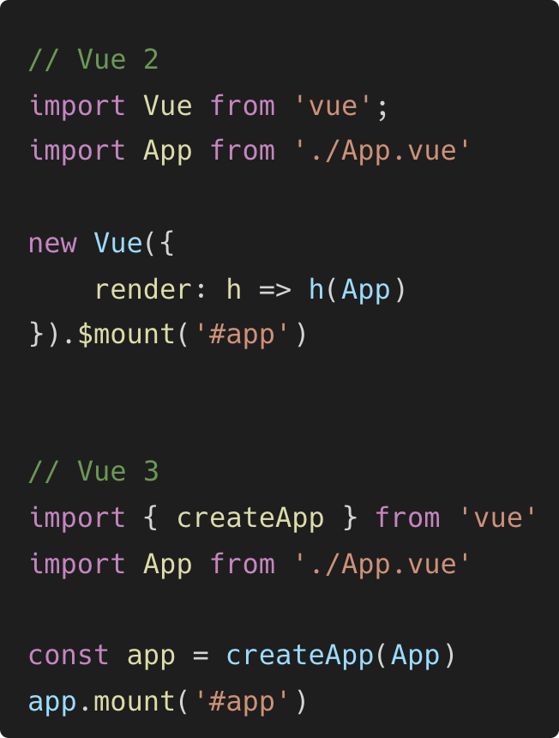
Breaking Changes
createApp
EventBus
Filter
Directive 生命週期名稱
Notes:
https://v3-migration.vuejs.org/breaking-changes/
https://v3.cn.vuejs.org/guide/migration/migration-build.html
https://medium.com/peerone-technology-%E7%9A%AE%E5%81%B6%E7%8E%A9%E4%BA%92%E5%8B%95%E7%A7%91%E6%8A%80/%E5%8D%87%E7%B4%9A-vue-3-%E5%89%8D-%E4%BD%A0%E5%BF%85%E9%A0%88%E8%A6%81%E7%9F%A5%E9%81%93%E7%9A%84%E6%94%B9%E5%8B%95-5891a297dbe2
https://book.vue.tw/appendix/migration.html

Slide 4
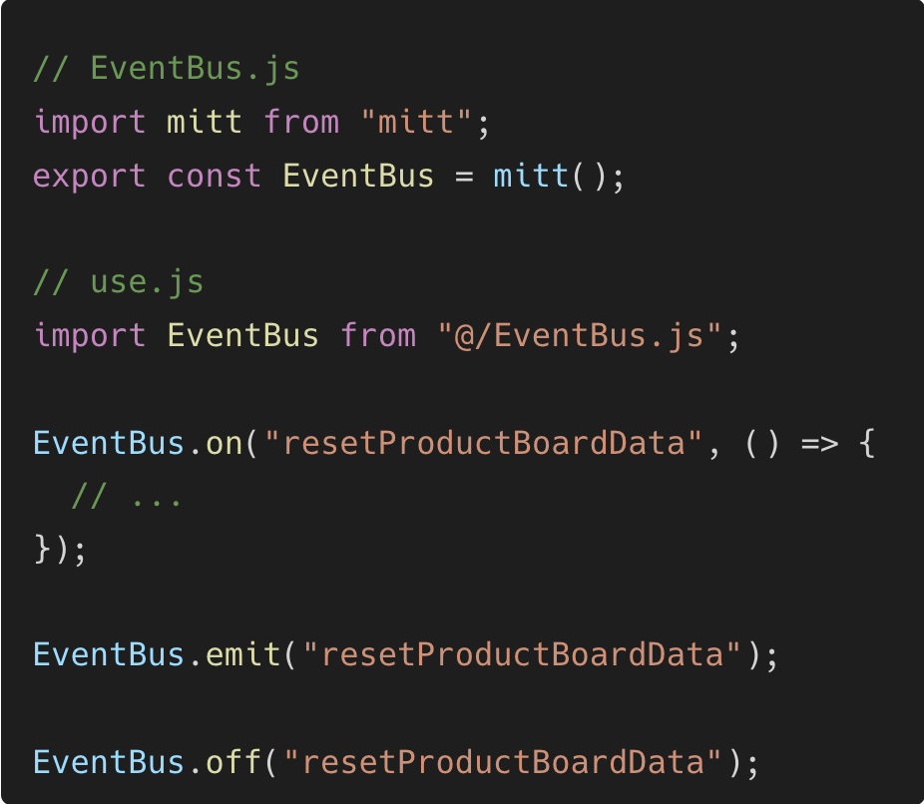
Breaking Changes
createApp
EventBus
Filter
Directive 生命週期名稱

Slide 5
Breaking Changes
created
bind → beforeMount
inserted → mounted
beforeUpdate
update → updated
beforeUnmount
unbind -> unmounted
createApp
EventBus
Filter
Directive 生命週期名稱

Slide 6
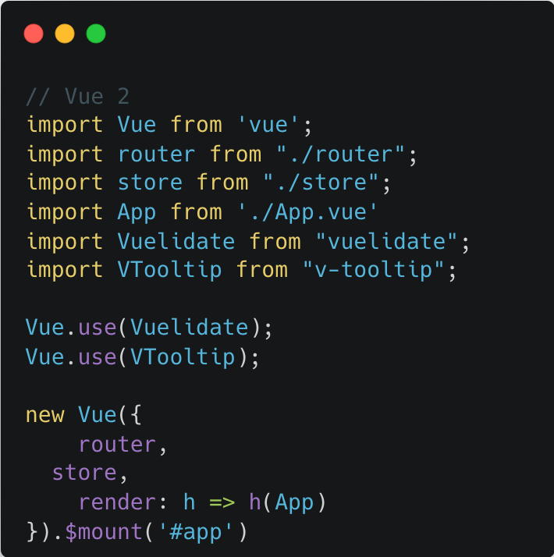
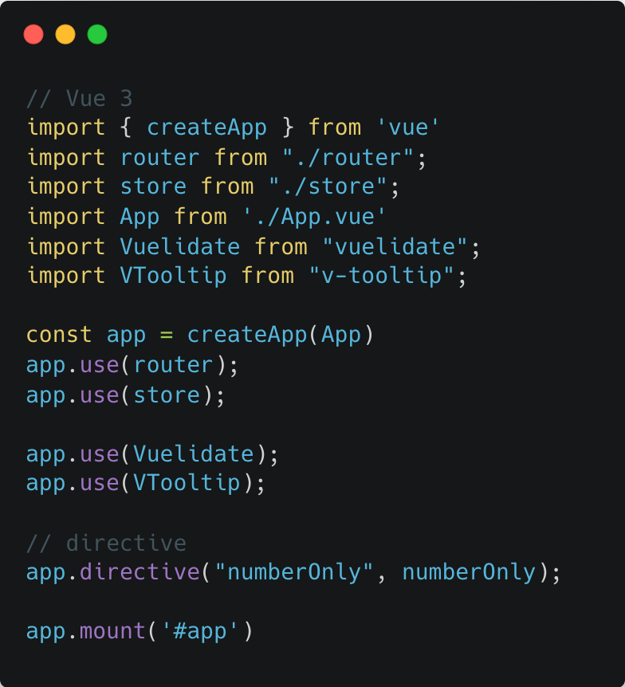
Vue - main.js

Slide 7
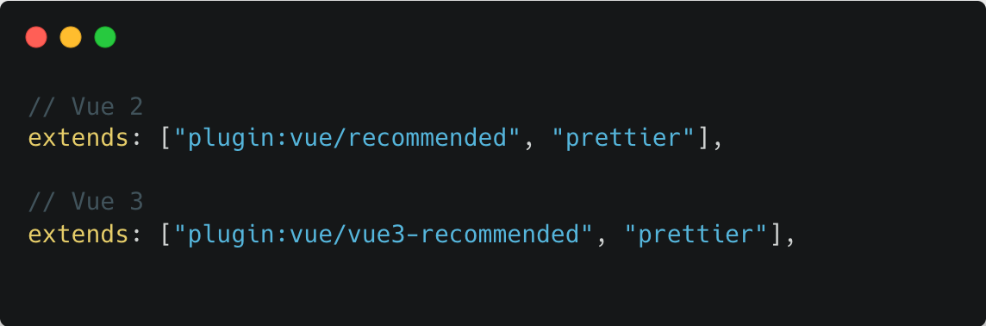
Vue - eslint
Notes:
https://eslint.vuejs.org/user-guide/#faq

Slide 8
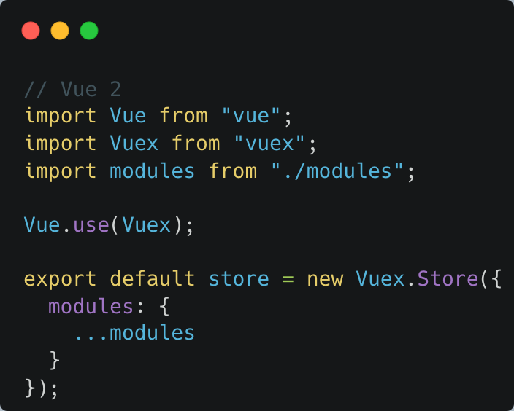
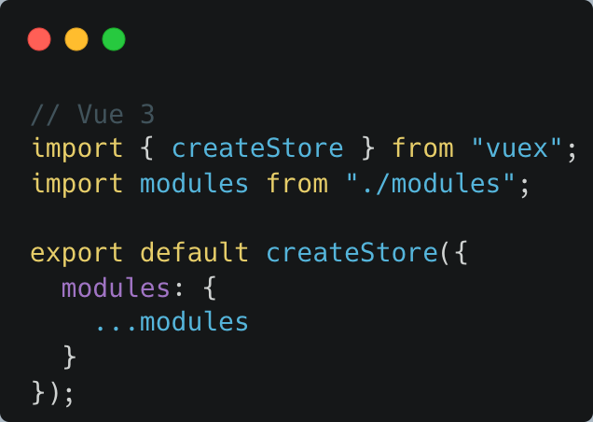
Vuex
Notes:
https://vuex.vuejs.org/guide/migrating-to-4-0-from-3-x.html

Slide 9
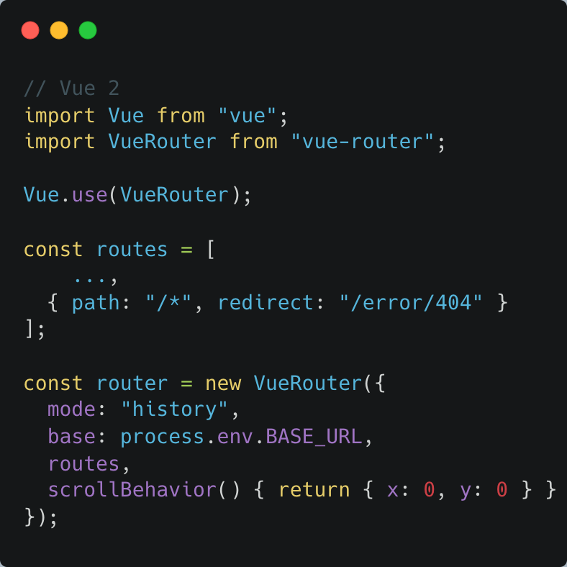
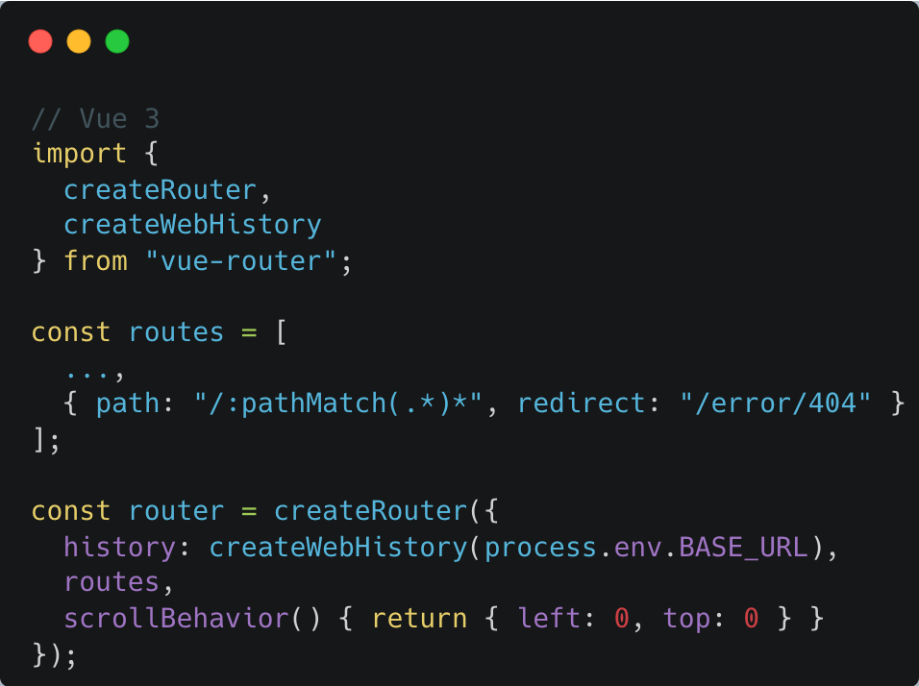
Vue Router
Notes:
https://router.vuejs.org/guide/migration/index.html

Slide 10
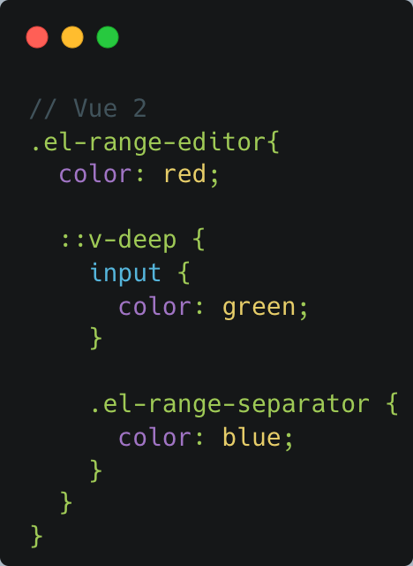
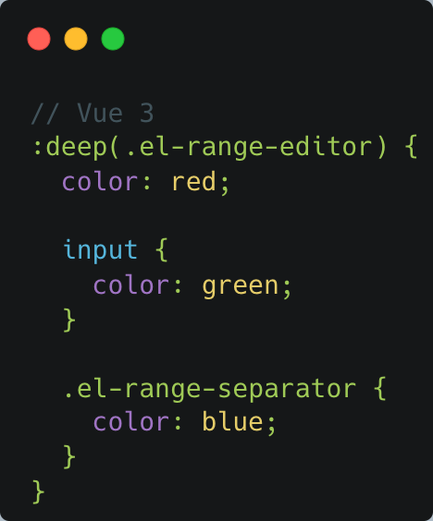
v-deep

Slide 11
v-deep

Slide 12
套件
Element-plus
Vuelidate
Notes:
Elemnt-plus 改樣式的方式變了，改用CSS變數。 Class name 改了 功能屬性改了
Vuelidate $each改成Nested validations

Slide 13
其他Changes
Transition v-enter → v-enter-from v-leave → v-leave-from
Plugin

Slide 14
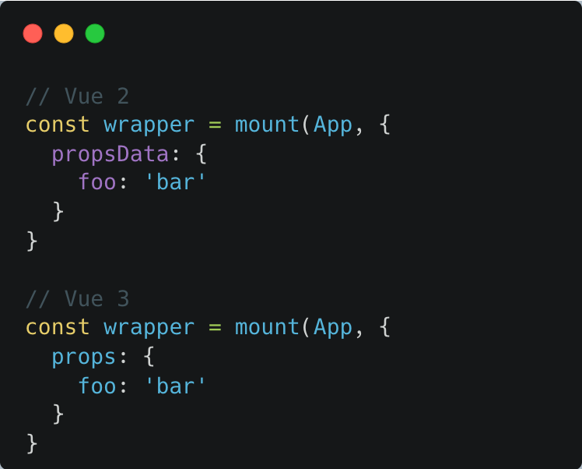
測試
propsData
createLocalVue
global
Notes:
https://test-utils.vuejs.org/migration/

Slide 15
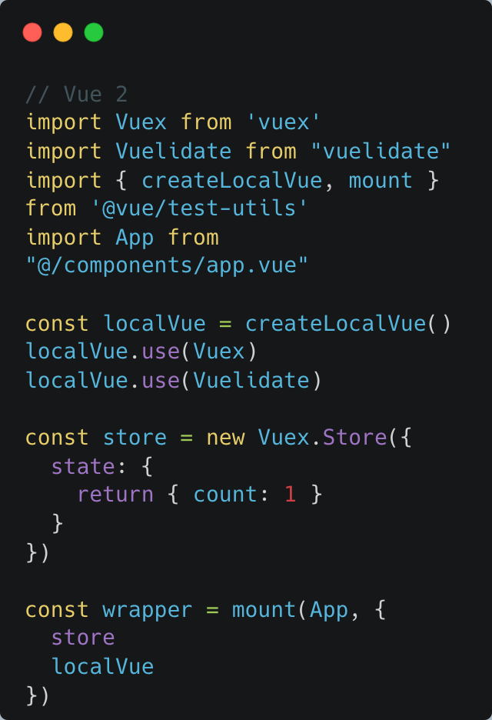
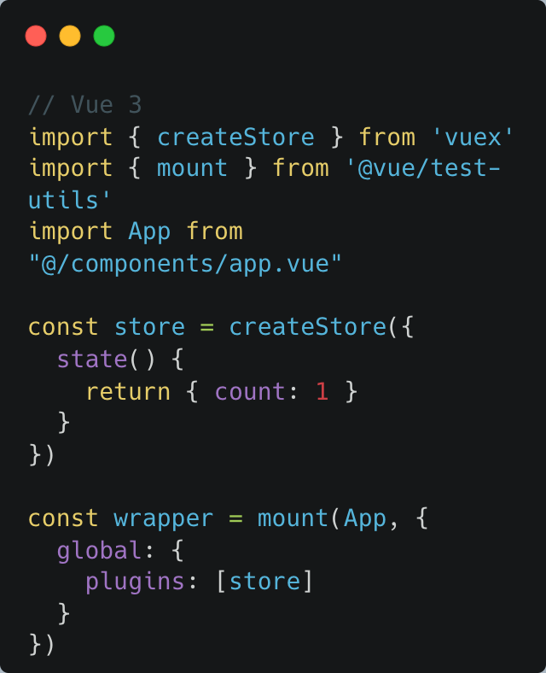
測試
propsData
createLocalVue
global

Slide 16
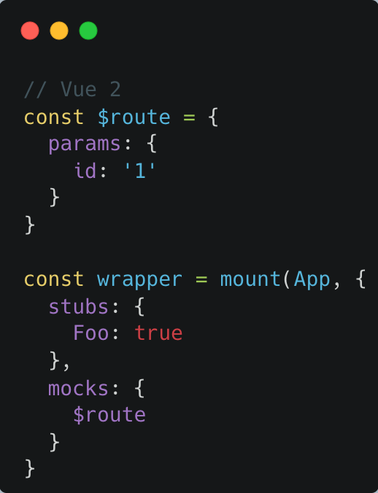
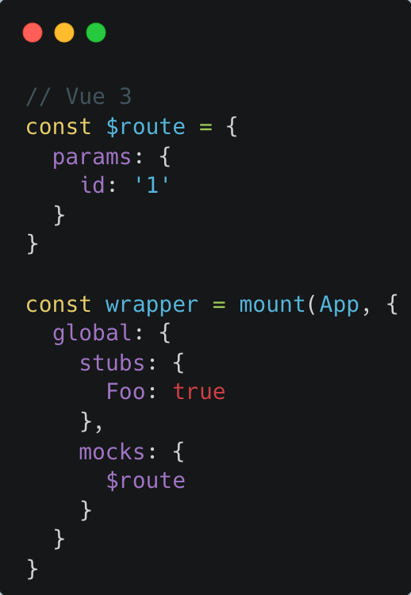
測試
propsData
createLocalVue
global

Slide 17
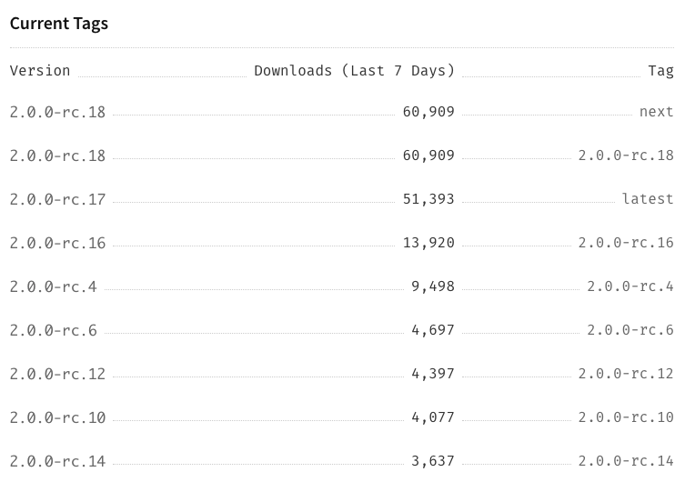
測試 – 版本
Notes:
https://www.npmjs.com/package/@vue/test-utils

Slide 18
Storybook
npx sb@next init
@storybook/vue: ^6.4.9
@storybook/vue: ^6.4.19
@storybook/vue3: ^6.4.19
Notes:
https://github.com/storybookjs/storybook/issues/10654

Slide 19
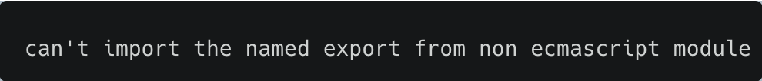
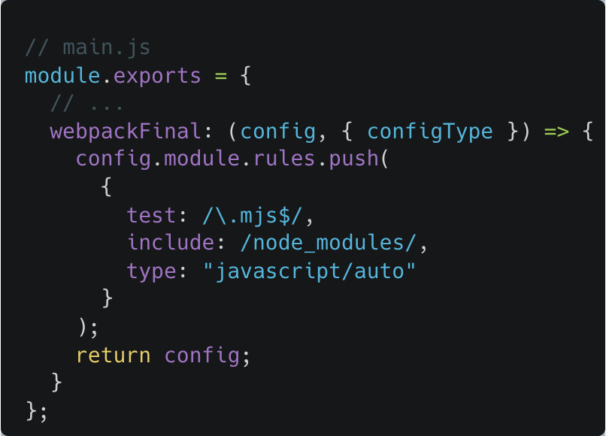
Storybook
Notes:
https://github.com/element-plus/element-plus/issues/3923

Slide 20
Storybook
Notes:
https://github.com/element-plus/element-plus/issues/3923

Slide 21
結語
升級前先做功課
動手改！！
測看看！！
後續的改寫

